Slide 1


MEDICAL INVENTORY OPTIMIZATION

Slide 2
Contents
Business Objective
Business Constraints
Project Architecture - Data Flow Diagram
Data Collection
Exploratory Data Analysis
Data Visualization
Notes:
Change

Slide 3
Business Problem
Bounce rate is increasing significantly leading to patient dissatisfaction.

Slide 4
Project Overview and Scope
Overview
There is higher bounce rate which leads to customer dissatisfaction. Here we analysed why there is higher bounce rate and what are the products which have higher bounce rate.
Scope
Delivers right type of medicines.
Improves customer satisfaction.
Reduces bounce rate and increase revenue.

Slide 5
Data Dictionary
VARIABLE NAME | VARIABLE DESCRIPTION
Typeofsales | Type of sale of the drug. Either the drug is sold or returned.
Patient_ID | ID of a patient
Specialisation | Name of Specialisation (eg. Cardiology)
Dept | Pharmacy, the formulation is related with.
Dateofbill | Date of purchase of medicine
Quantity | Quantity of the drug
ReturnQuantity | Quantity of drug returned by patient to the pharmacy
Final_Cost | Final Cost of the drug (Quantity included)
Final_Sales | Final sales of drug
RtnMRP | MRP of returned drug (Quantity included)
Formulation | Type of formulation
DrugName | Generic name of the drug
SubCat | Subcategory (Type) to the category of drugs.
SubCat1 | Subcategory (condition) to the category of drugs

Slide 6
Exploratory Data Analysis [EDA]
Statistical Insights
Business Insights
The mean is greater than median and mode for all the numerical columns.
There is high variance and standard deviation in the data.
Skewness is closer to 1 indicates the data is skewed right.
Kurtosis is greater than 3 indicates the distribution is more narrower.
From above all the points the distribution has long tail at right means the higher values has lower frequency and lower values has higher frequency
There is 23.35% of bounce rate which indicates approximately quarter portion of the customers returning the products.
Lotions, Pessaries & Suppositiries and IV Fluids, Electrolytes, TPN have bounce rate greater than 20%.
Injections, and IV Fluids, Electrolytes, TPN are the products have higher rate of return quantity.
On the month of may there is higher bounce rate i.e., 27% compared to other months and January, September has least bounce rate i.e., 17%.
There are 6 categories which have bounce rate greater than 15%.
Notes:
EDA is used for seeing what the data can tell us before the modeling task.
Change

Slide 7


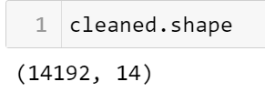

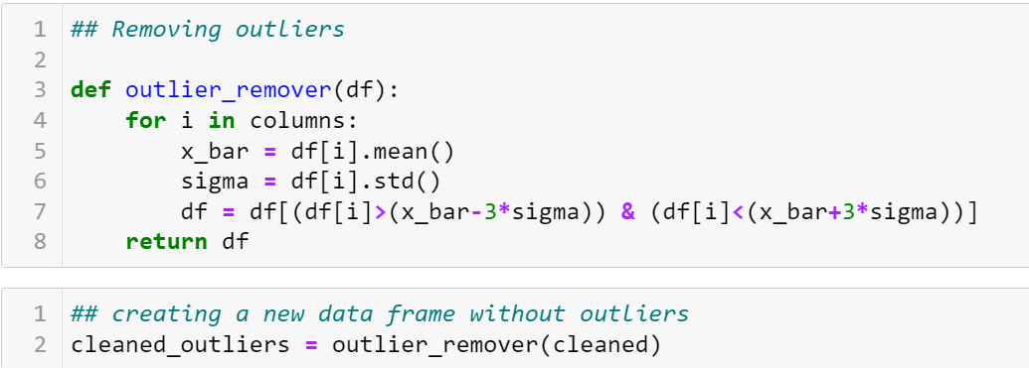

Data Preprocessing
Changing the format of dateofbill from text to date. Shape of the dataset at each stage
Replacing Null values with unknown
Removing duplicates from the dataset
Removing outliers from the dataset using normal distribution property of 3 standard deviation covers 99.7% of area | data.
Notes:
Keep observations

Slide 8
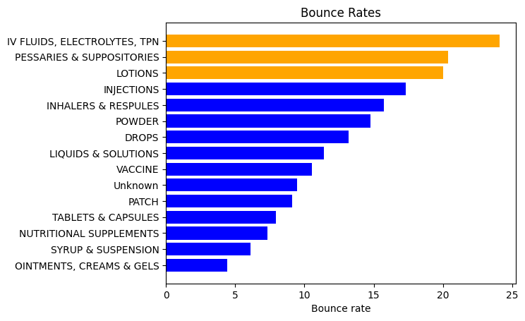
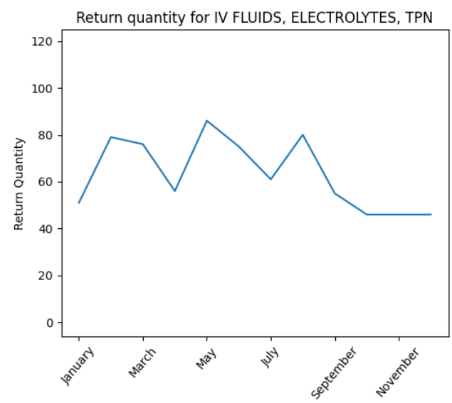
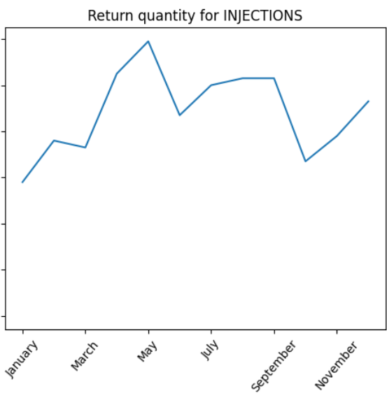
Data Visualization
Lotions, Pessaries & Suppositories and IV Fluids, Electrolytes, TPN has higher bounce rate. This may because users searching for these products have specific need if the description of the product doesn’t satisfy the user may return back.
Categories IV Fluids, Electrolytes, TPN and Injections has higher quantity returning rate on the month of may. IV Fluids, Electrolytes, TPN has less quantity return on the month of October and injections on month of January.
Notes:
Add graphical

Slide 9


